Slide 1


Slide 2
Description Of Data
This data set downloaded from Kaggle, it is about “LOAN PREDICATION”
The Column of our data set,
VARIABLE | DESCRIPTION
Loan _ ID | Unique Loan ID
Gender | Gender
Married | Applicant married (Y/N)
Dependents | Number of dependents
Education | Applicant Education (Graduate/ Non-Graduate)
Self _ Employed | Self employed (Y/N)
Applicant Income | Applicant income
Co-applicant Income | Co-applicant income
Loan Amount | Loan Amount
Loan _ Amount _Term | Term of loan in months
Credit _ History | credit history meets guidelines
Property _ Area | Urban/ Semi Urban/ Rural
Loan _ Status | Loan approved (Y/N)

Slide 3
PROBLEM STATEMENT
The loan eligibility process based on customer detail provided while filling online application form. These details are Gender, Marital Status, Education, Number of Dependents, Income, Loan Amount, Credit History and Property area.
In our analysis, we work with some Model Buildings in this data set based on given details and we predict the Model Accuracy score.

Slide 4
Tools we used in our Project,
DATA VISUALIZATION:
Microsoft Excel
Tableau
DATA PREPROCESSING:
Python3
MODEL PREDICTION:
Decision Tree Classifier
Logistic Regression
Random Forest Classifier
KNN Classifier

Slide 5
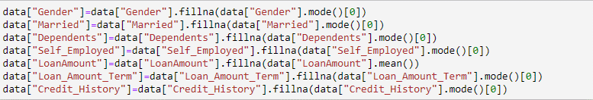
OBSERVATIONS:
In this data set, We have 614 rows and 13 Columns.
Our project data types were Object, Int64 and Float64, and it was a
2-D data set.
We have some null values in our data, so we replaced using these Functions:

Slide 6

In this Data Set,
69% Of Loan Applications has been Approved.
31% Of Loan Applications has been Rejected.

Slide 7
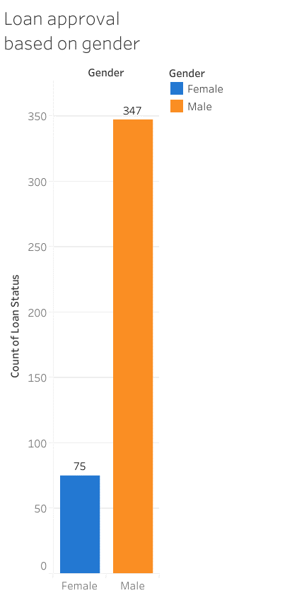

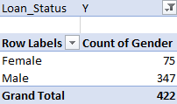
Number of Female – 18%
Number Of Male - 82%
Male Applicants are higher than Female Applicants.
Loan Status based on Gender,
Loan Approved[Female] – 75
Loan Approved[Male] - 347
So Obviously, Count Of Male Applicants are getting loan higher than Female Applicants.

Slide 8
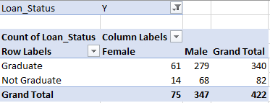
In this Chart, We Compare Education as well as Gender.
So already we seen, Count Of Male Applicants are Higher than Female Applicants.
Count Of Graduates Applicants are Higher than Non-Graduate Applicants.
So, Male Graduate Applicants got more Loan Approval.

Slide 9
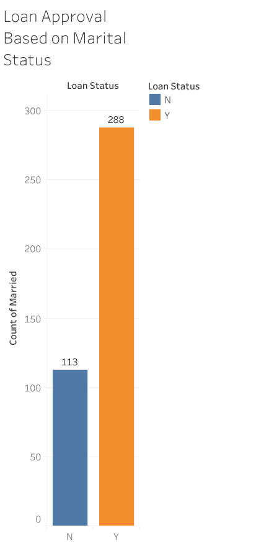

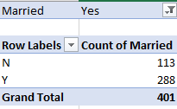
Number of Married – 401
Number Of Unmarried - 213
Loan Status Of Married Applicant,
Loan Approved – 288
Loan Rejected - 113
In this data set, 65% Applicants are Married.
In that Married Applicants, 72% Applicants are getting Loan.
So we Conclude, Marital Status plays a Vital role in Loan Application.

Slide 10
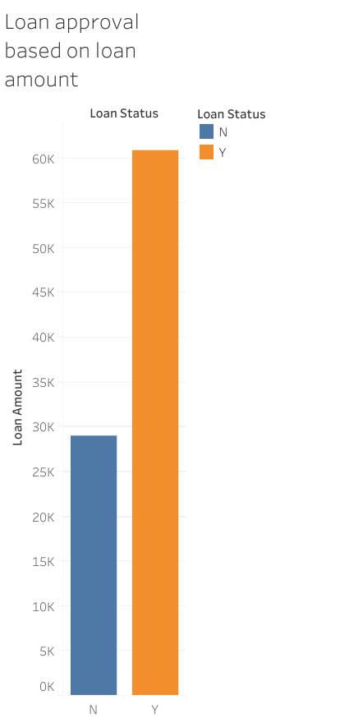
LOAN APPROVAL BASED ON
LOAN AMOUNT
Approved > Rejected
Formulas we used,
=IF(I2>=150,"HIGH",IF(I2<150,"LOW"))
=COUNTIFS(N:N,"HIGH",M:M,"Y")
If the Loan Amount was Low, the Count of Loan Status is 287.
If the Loan Amount was High, the Count of Loan Status is 135.
Using IF and COUNTIFS condition, We find the Loan Amount Approved when the Loan Amount was Less.

Slide 11

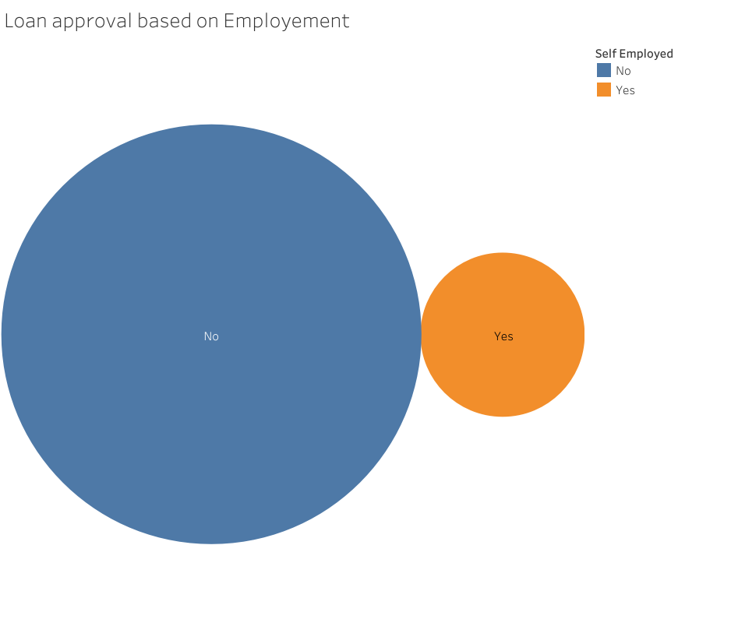
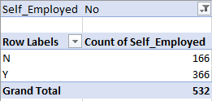
86% of Applicants are Un-Employed
Un-Employed Applicants are getting Higher Percent Of Loan Approval.

Slide 12
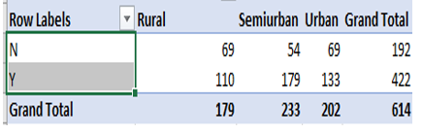
In Property based we have three Areas,
Semi Urban
Urban
Rural
Comparing these three Areas,
Semi Urban Area had More count of Loan Approval.
Rural Area had Less Count of Loan Approval.

Slide 13
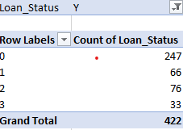
58% Applicants have 0 dependent
16% Applicants have 1 dependent
18% Applicants have 2 dependent
8% Applicants have 3 dependent
So we Conclude, Non-dependent Applicants got Higher Percentage Of Loan Approval.

Slide 14
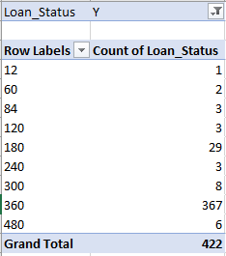
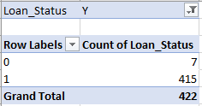
Based on Loan Amount Term,
Term Of 360 has 87% of Loan Approval.
Based On Credit History,
Credit History Of 1 has 98% Approval.

Slide 15
Main steps for model building
Seperate Dependent and Independent Variable.
Spliting data Train and Test.
Create a Model( Fit, Pred)
Check Model Performance(Accuracy)

Slide 16
CONCLUSION
Accuracy Score for Models,
Decision Tree Classifier – 73%
Logistic Regression - 80%
Random Forest Classifier - 78%
KNN Classifier - 60%
So we conclude Logistic Regression is best Model for this Loan Prediction Of Our Data Set, because Logistic Regression has Higher Accuracy Score.

Slide 17



